Slide 1
Meme Review:
Dead or Alive?
Phase 2
Predicting Reader Response to Timely Memes using Machine Learning

Slide 2

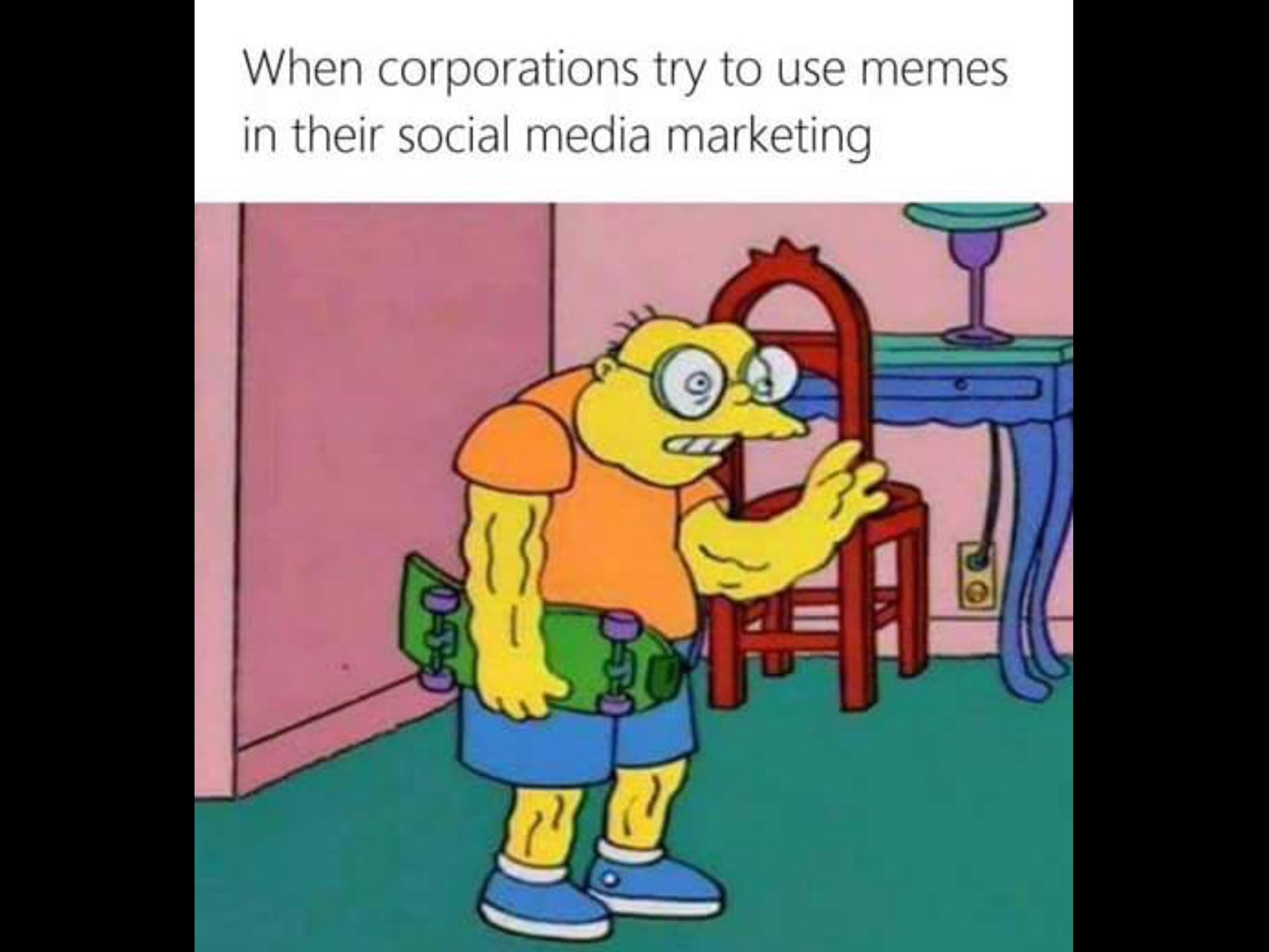
Motivation & Problem Definition Recap
2 out 5 Facebook posts are memes
Memes are a great marketing tool
Millennials LOVE memes
Online Businesses and Influencers
Massive Data dump

Slide 3
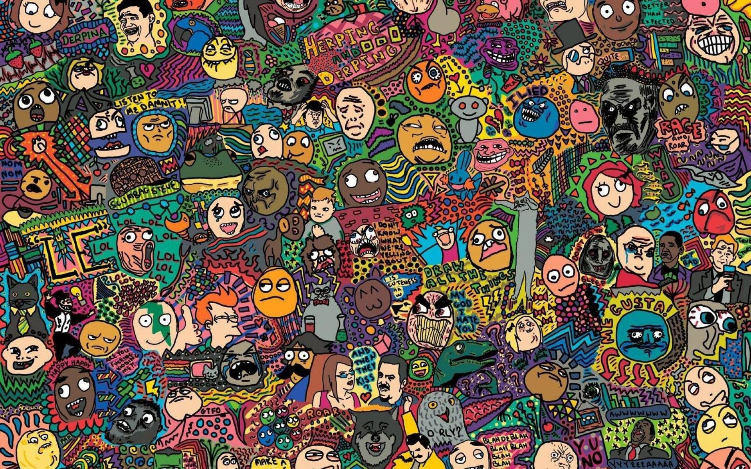
Background
What we set out to learn
How the internet affects many variants of people
How internet memes gained and maintained popularity
How images are shared in internet media
How to automatically find classifiable features
How to cluster similar looking images

Slide 4
“Insights into Internet Memes”
It is commonly assumed that Internet memes spread virally but scientific evidence as to this assumption is scarce.
Investigate the epidemic dynamics of 150 famous Internet memes.
The analysis is based on time series data that were collected from Google Insights, Delicious, Digg, and StumbleUpon.

Slide 5
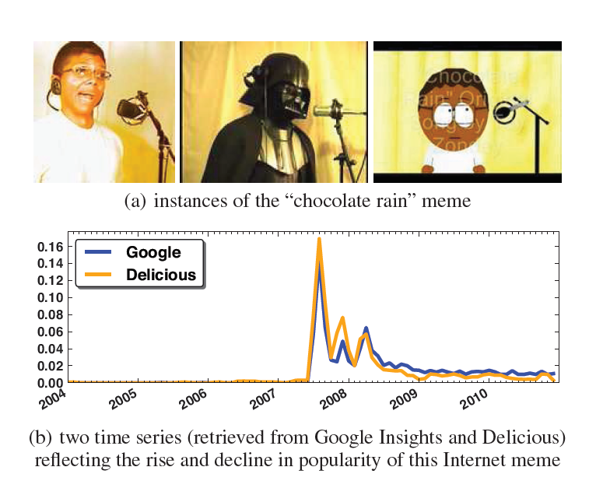
Found that differential equation models from mathematical epidemiology as well as simple log-normal distributions give a good account of the growth and decline of memes.

Slide 6
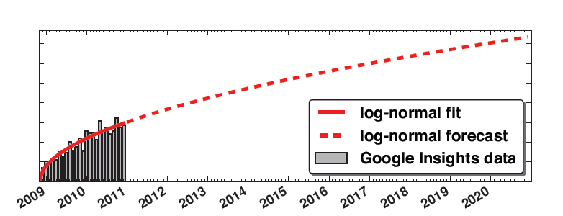
Traditional compartment models might be good but lack flexibility.
Log-normal distributions are more practical.
Thus, concluding by saying memes might be viral but only on social media platforms and not the rest of the internet.

Slide 7
“Predicting the Content Diffusion Path in Online Social Networks”

Slide 8
“Marketing with Twitter:
Challenges and Opportunities”
255 million monthly active users
Specific features may have more overall effect in the final decision of a user response
Upvotes, Author, Dates

Slide 9
“A Study of Meme Propagation”
Memes gain momentum and then lose their popularity over time
Categorized the Memes, i.e. Political memes vs General Memes

Slide 10
“Going Deeper with Convolutions”
Google’s own research paper proposing the Deep Convolutional Inception Neural Net
By C. Szegedy & 8 others from Google Inc, University of North Carolina and
Published to Cornell’s ArXiv on the 17th of September 2014
ImageNet Large-Scale Visual Recognition Challenge 2014 1st Place Winner for Classification and Detection.

Slide 11
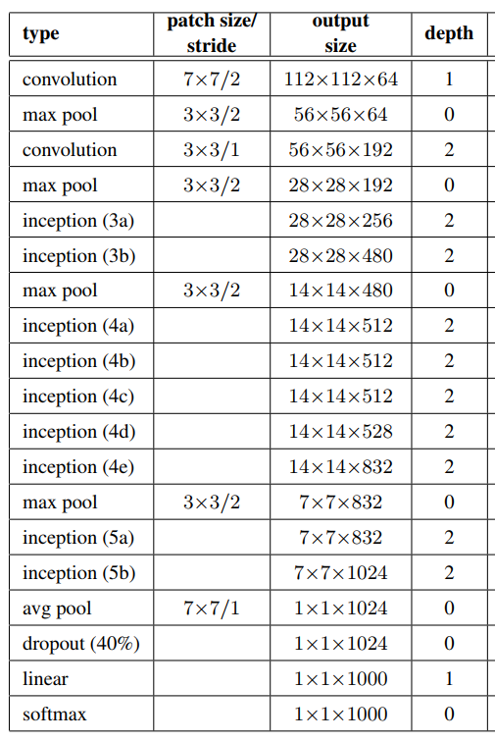
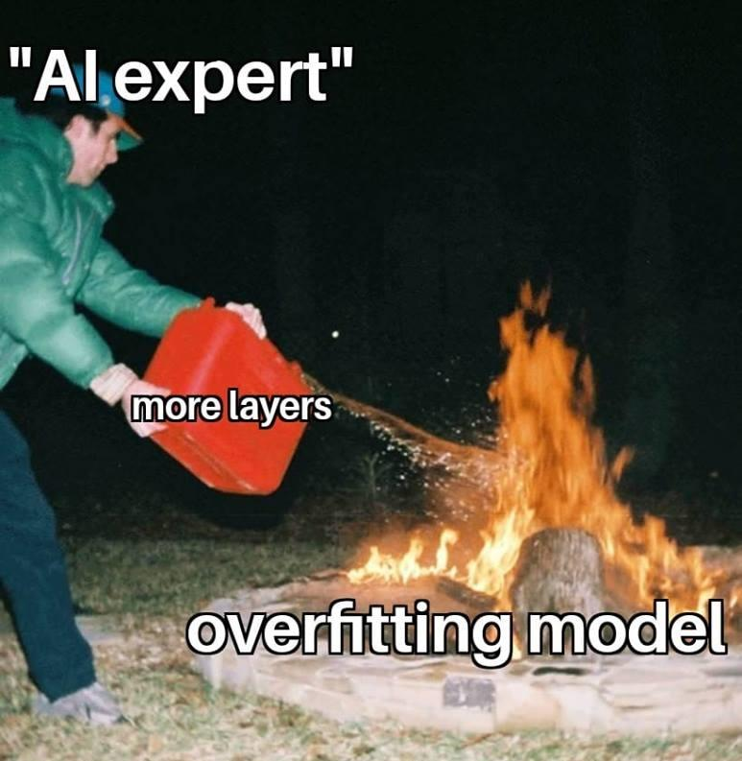
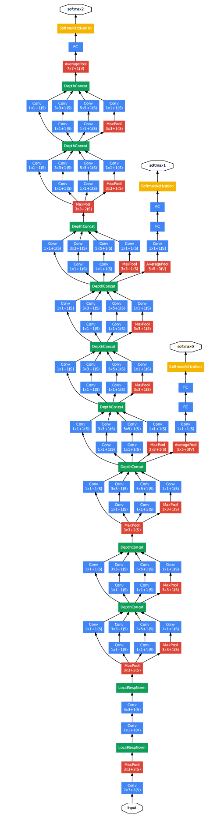
Confusing Convolutions

Slide 12
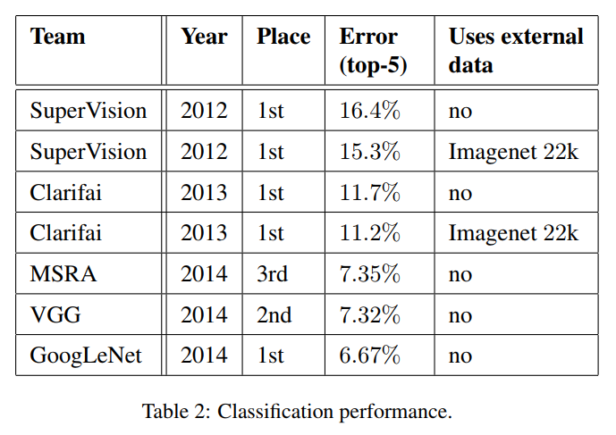
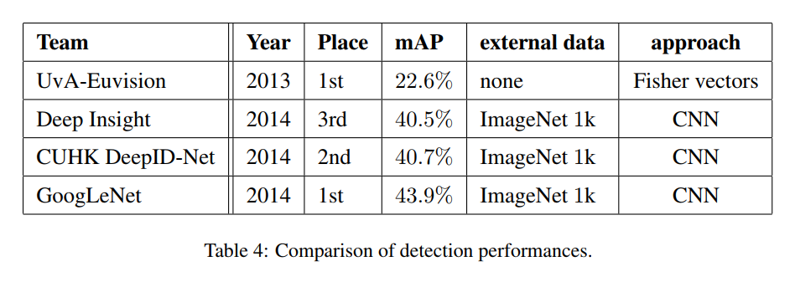
Stats and Scores

Slide 13
“Visualizing Data using TSNE”
T-Distributed Stochastic Neighbor Embedding
Published by Laurens van der Maaten of Tilburg University and Geoffrey Hinton of University of Toronto
First published to The Journal of Machine Learning Research on the 9th of November 2008

Slide 14
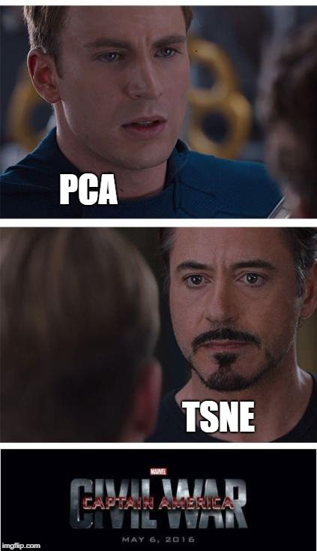
Dimension Warping
TSNE is a Dimensionality Reduction technique
TSNE Projection can map and cluster High Dimensional Data to a 2D or 3D Space by representing noticeable features as vectors

Slide 15
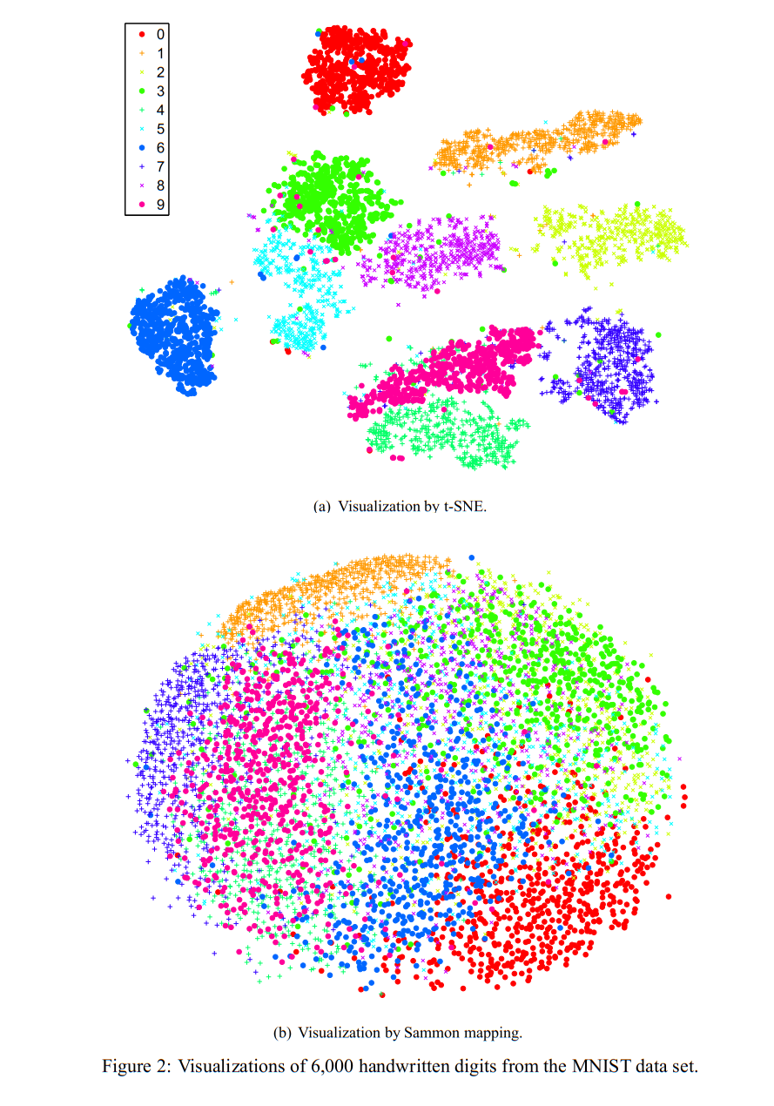
Easily Separable Classifications
Optimized for learning and preserving non-linear patterns in HD datasets

Slide 16
Back to
Meme Review
What have We done so far?

Slide 17

Our Data Source & Preprocessing
Kaggle
Reddit meme dump
JSON metadata
Image Preprocessing
Resize Resolution
Convert All images to JPG
Process JSON metadata
Messy JSON Organization
UNIX-based UTC Timestamp

Slide 18

Neural Networks
Inception
Used before the TSNE Cluster to produce classifiable features
AlexNet
VGGnet

Slide 19
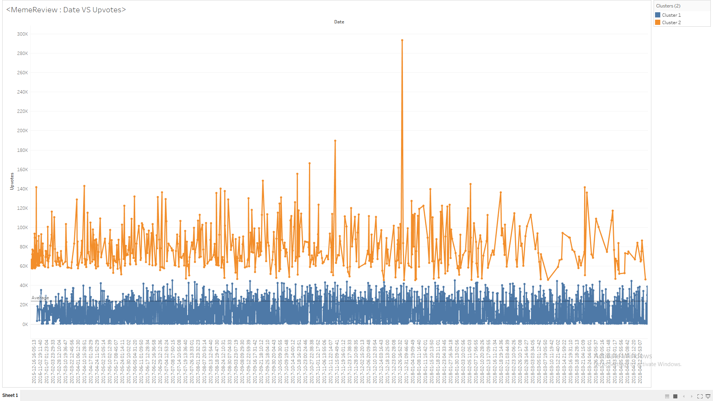
Data Visualization of Correlations
Graph: Date vs Upvotes

Slide 20
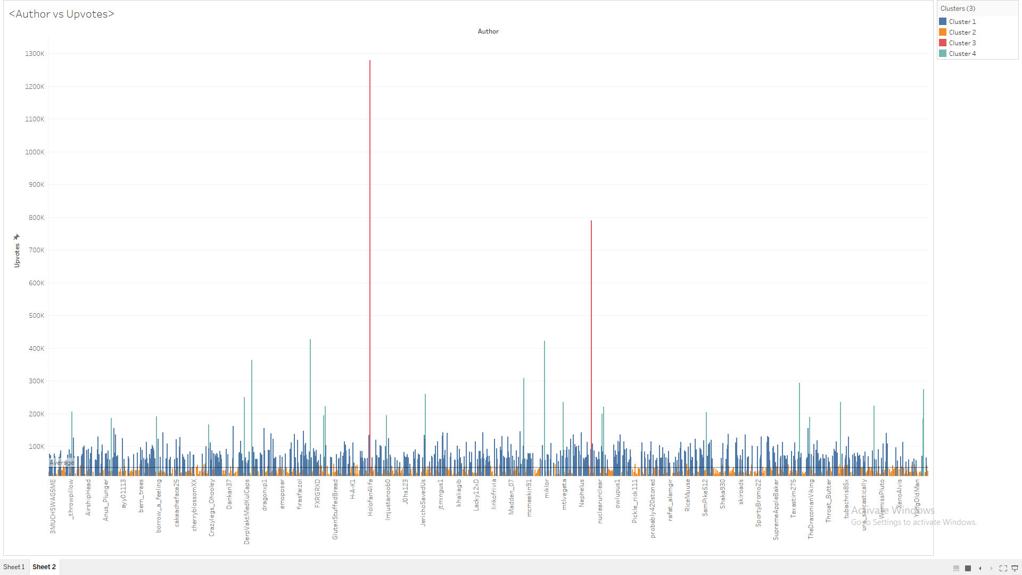
Data Visualization of Correlations
Graph: Author vs Upvotes

Slide 21
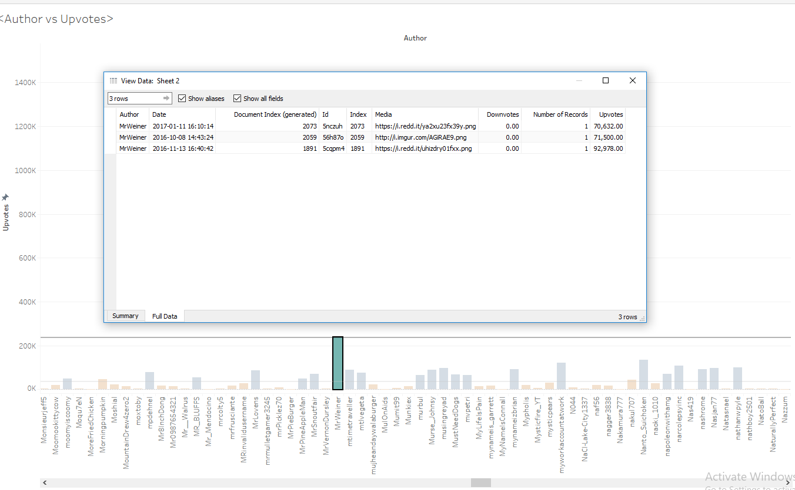

Slide 22
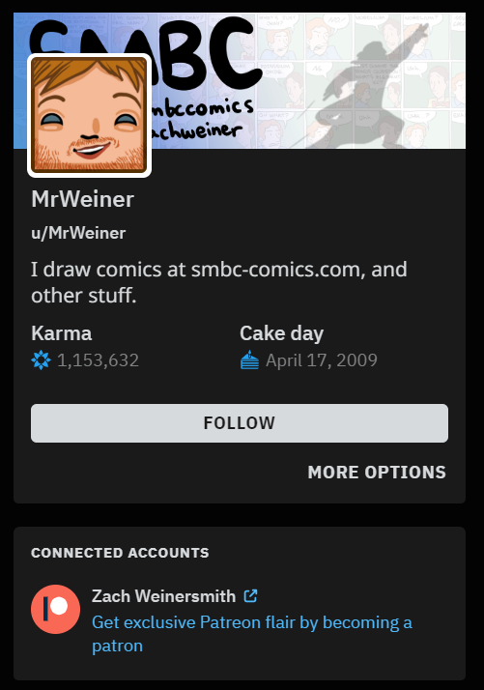
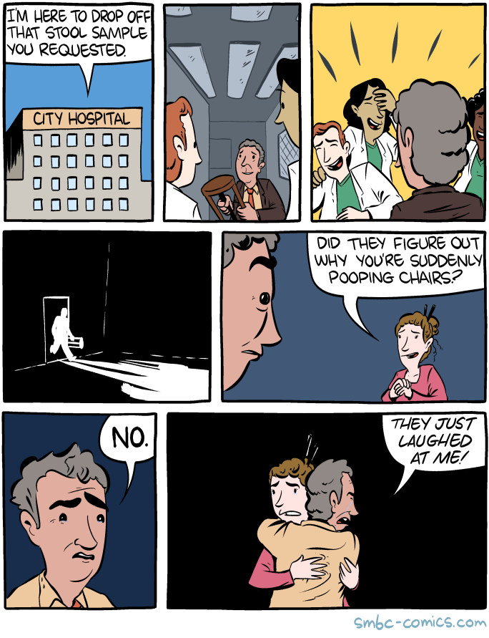
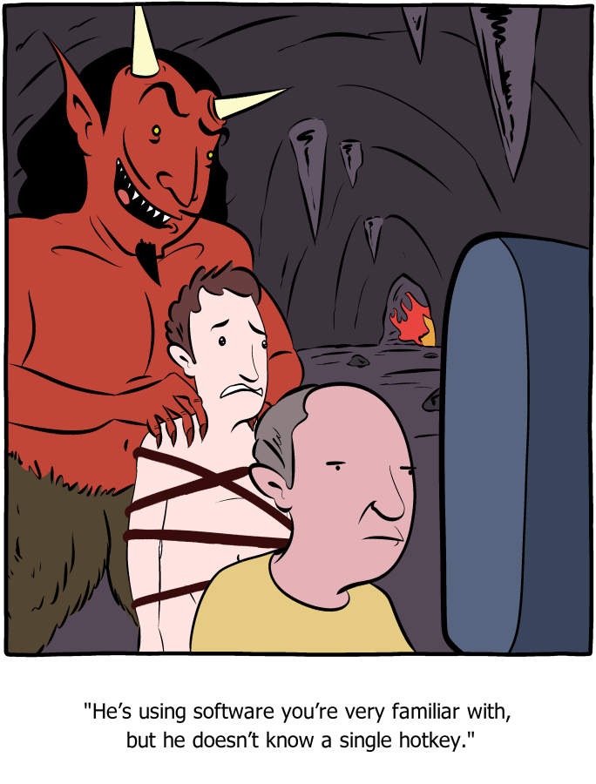
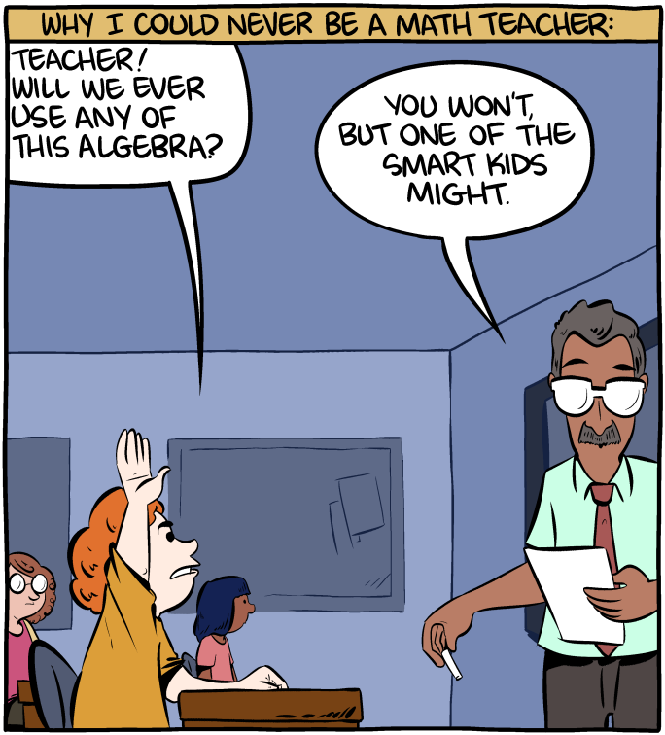

Slide 23
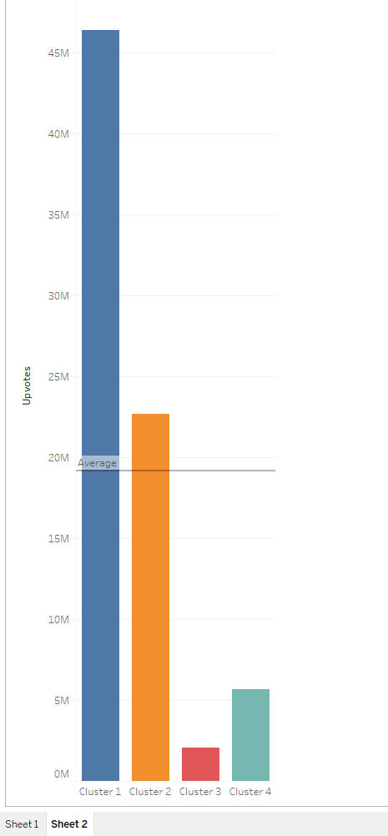
Author Clusters
4 Types
of
“Meme-creators”

Slide 24

See in Numbers
Produce Image Vectors from Inception Object Detection Net node weights using TF
Use previous Vectors for Clustering UMAP, which is very similar to TSNE, to project onto an HTML Canvas running D3.js

Slide 25
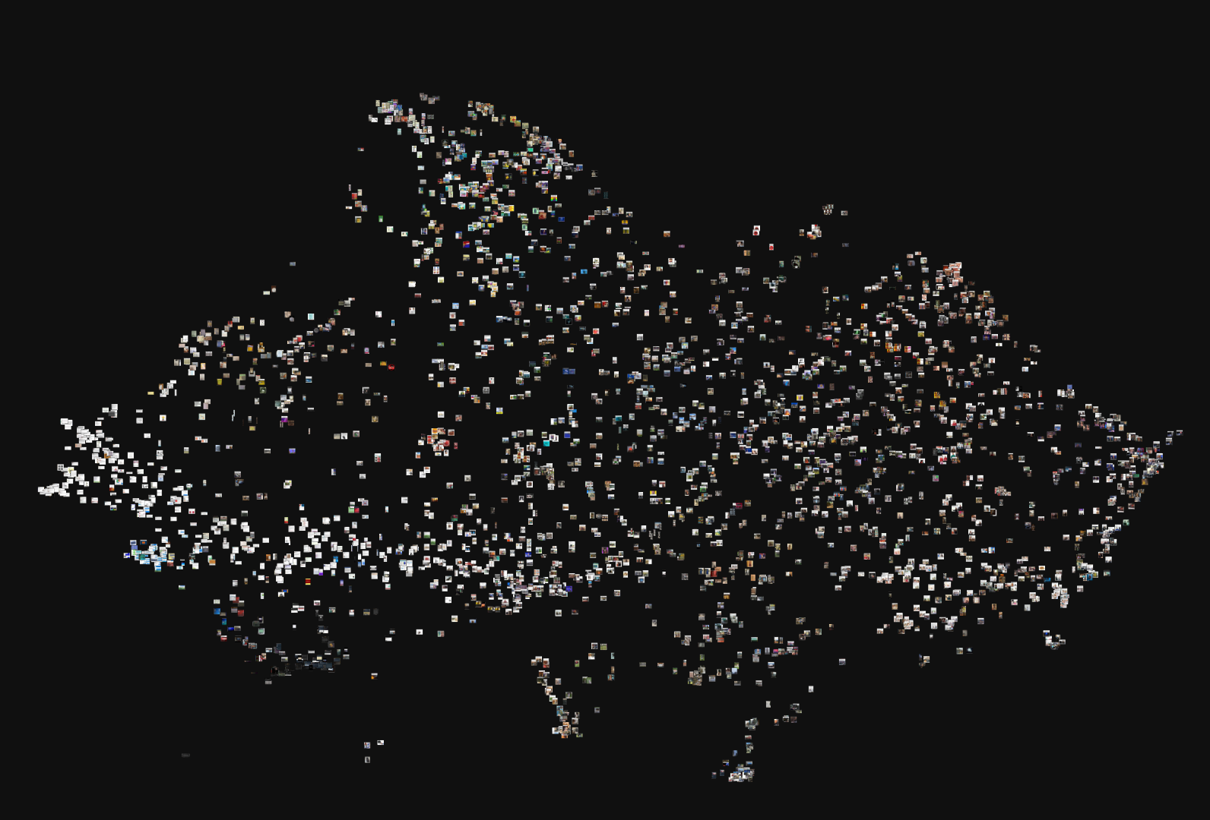
A UMAP Map of Memes

Slide 26
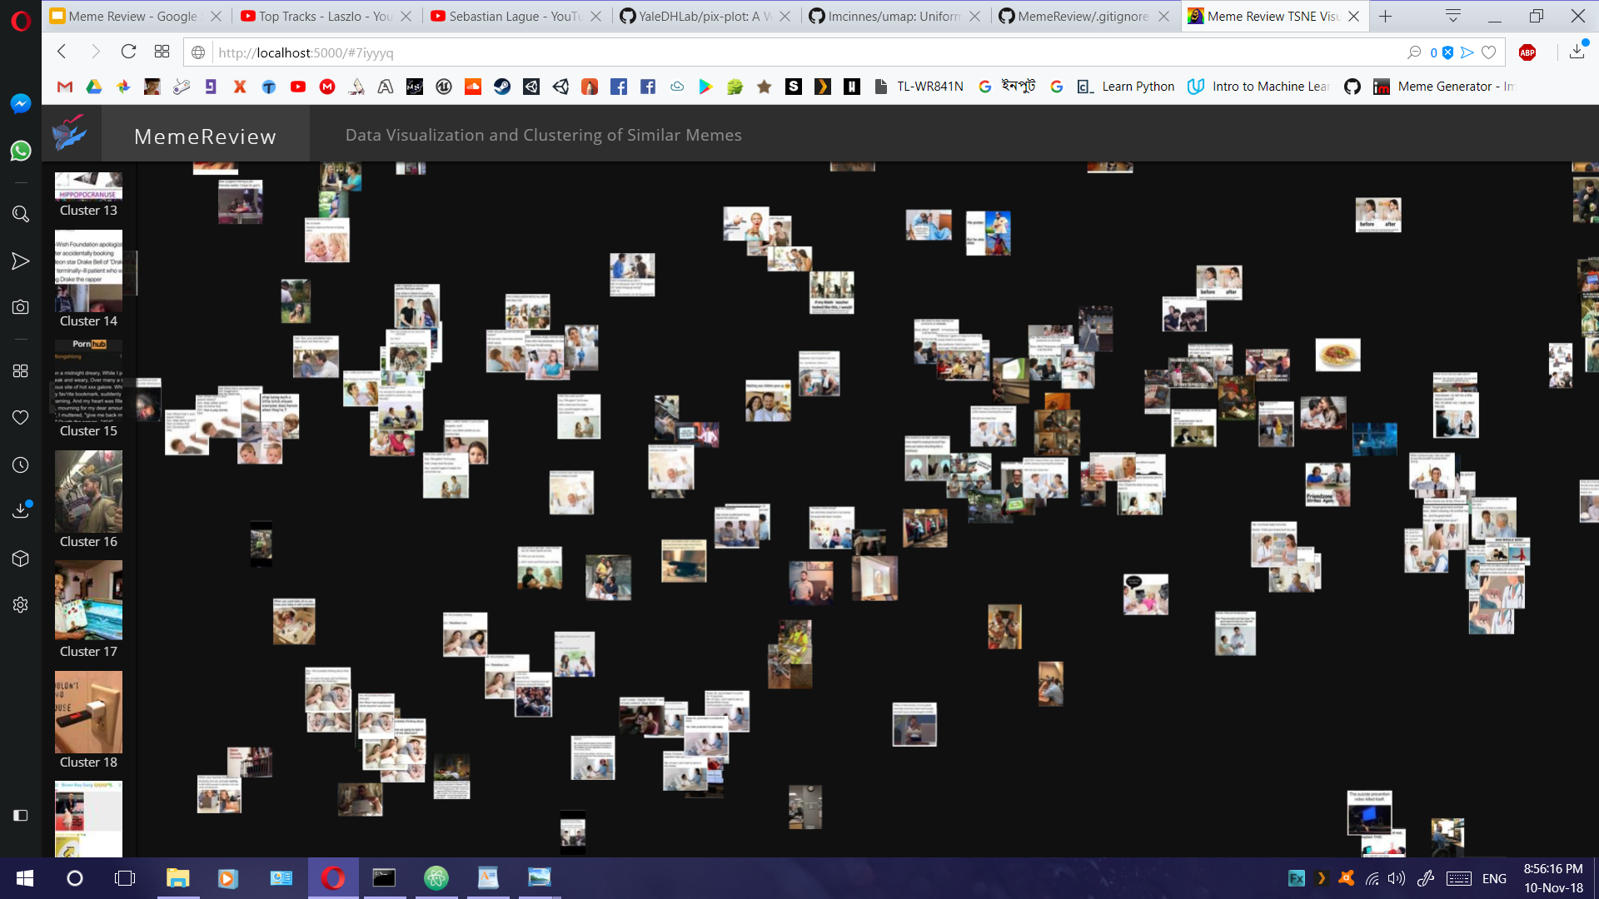
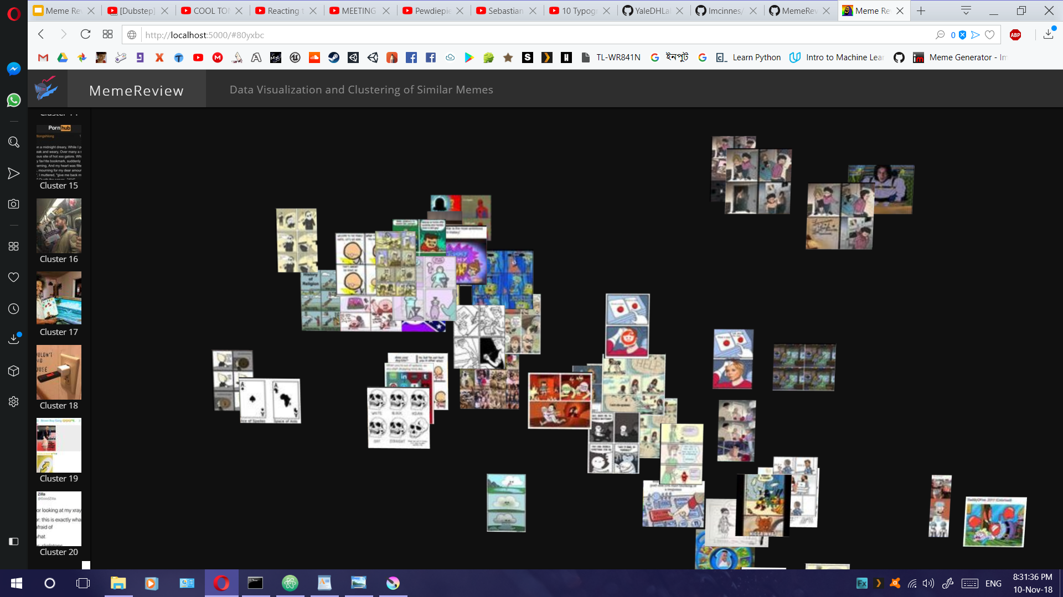
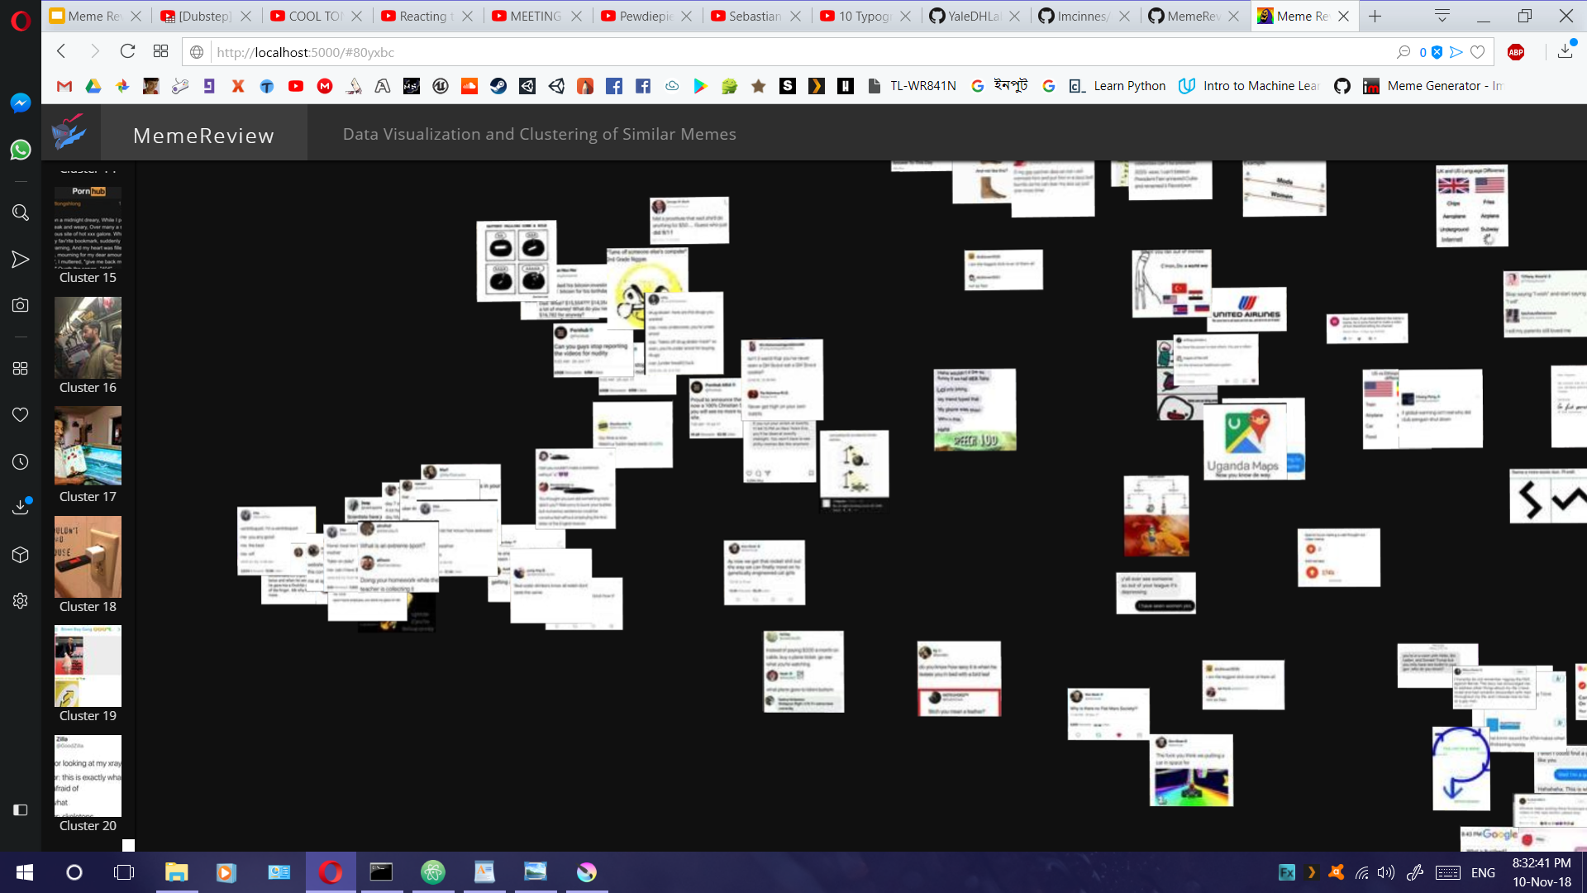
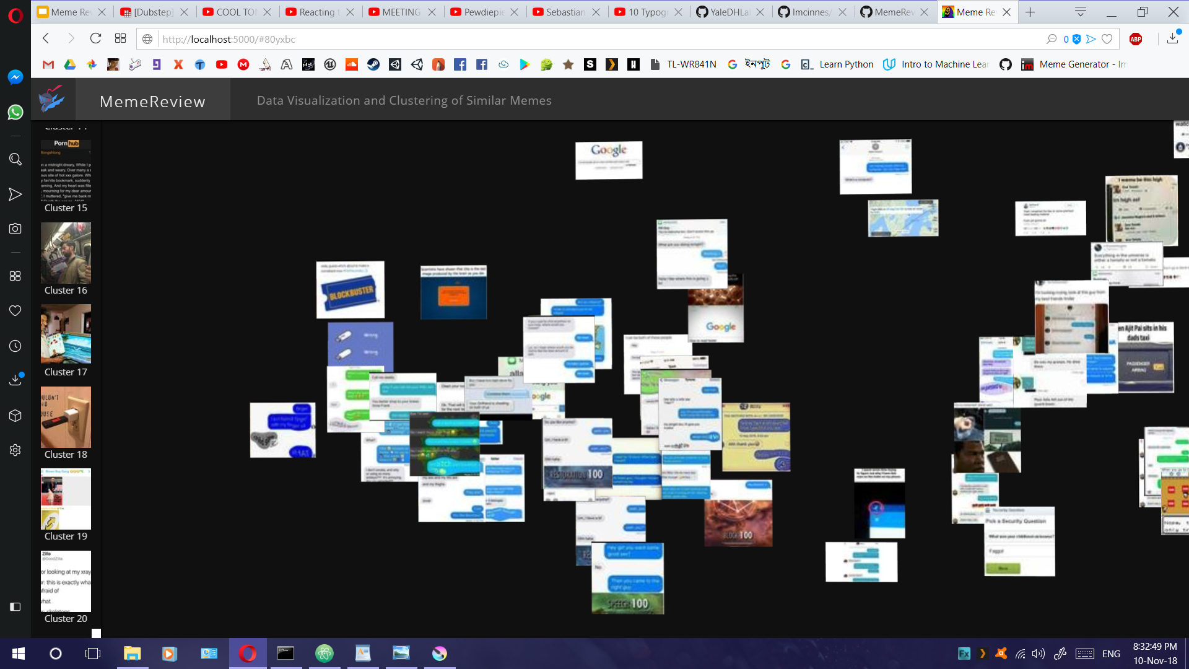
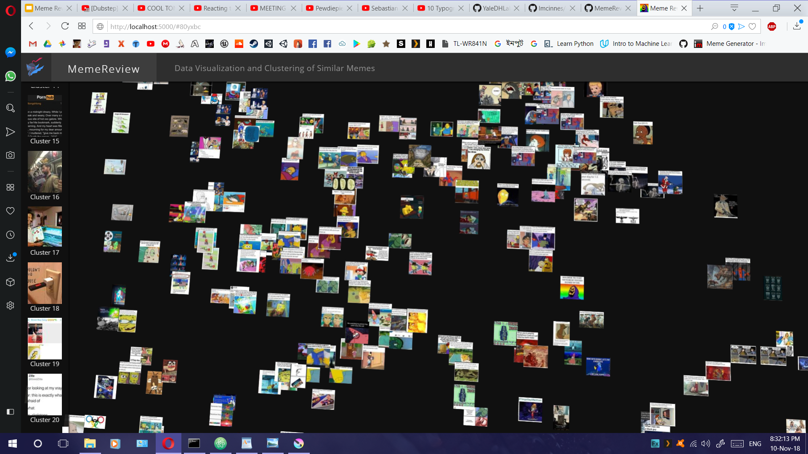
Clusters of Memes

Slide 28
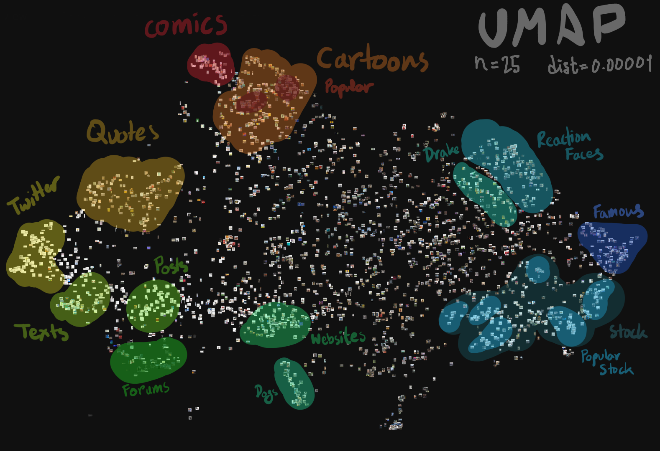

Slide 29
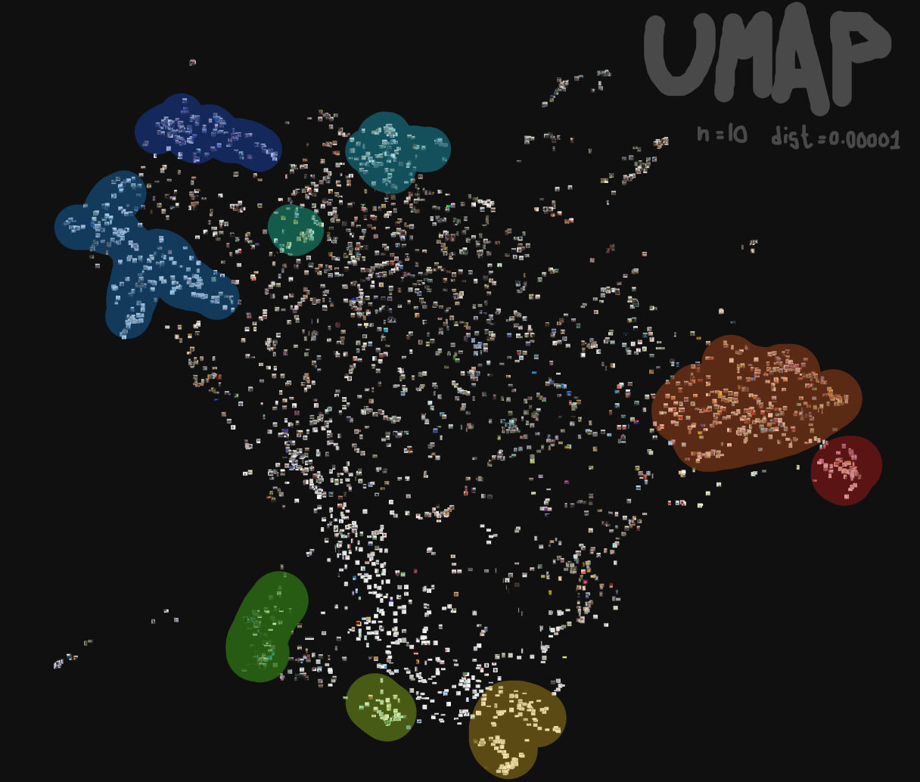
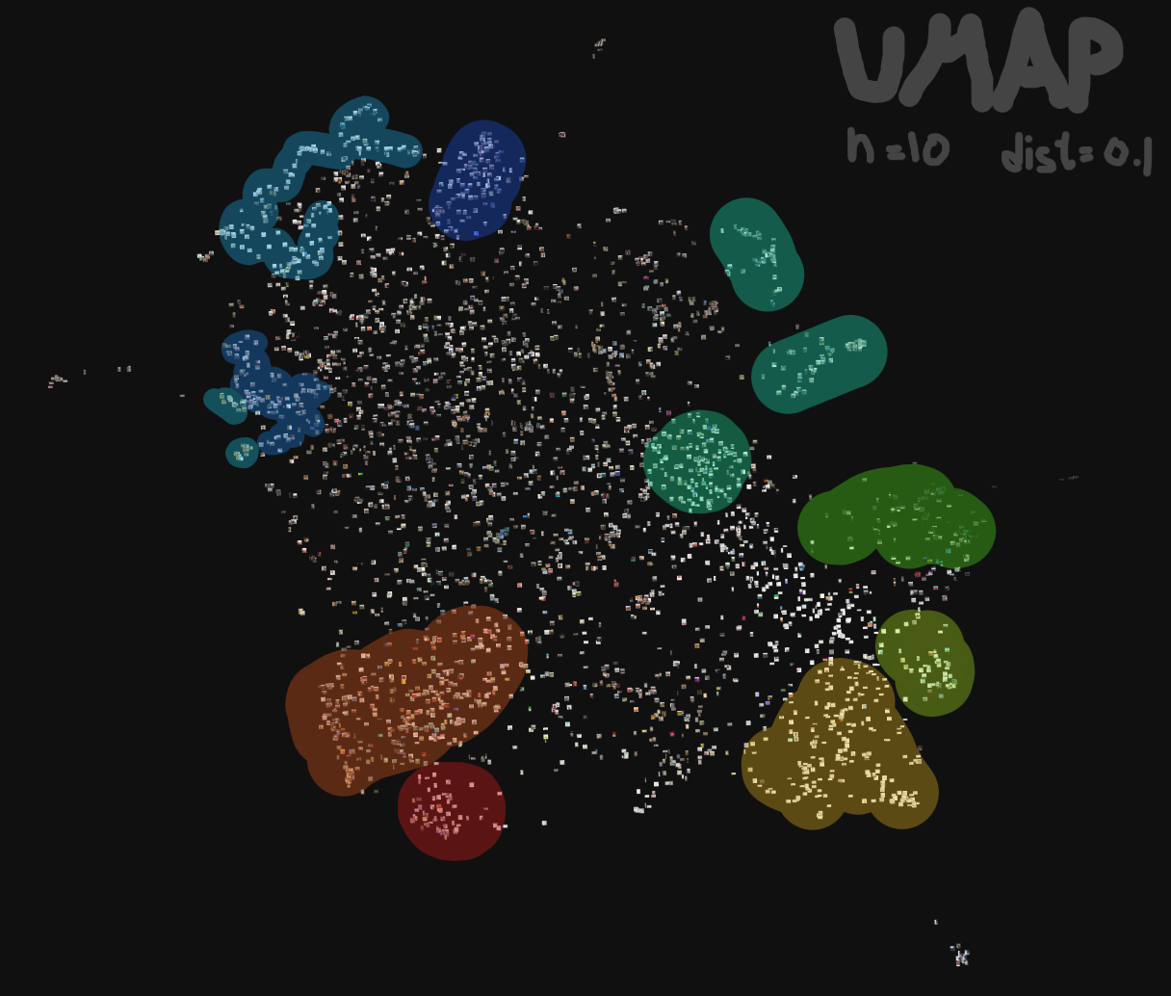
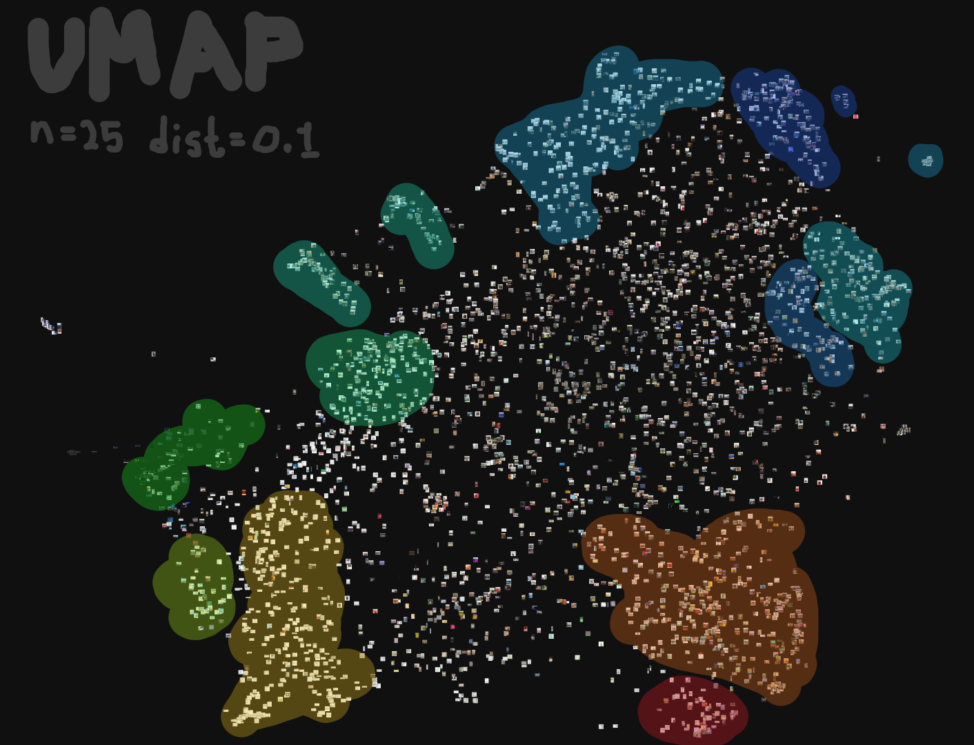
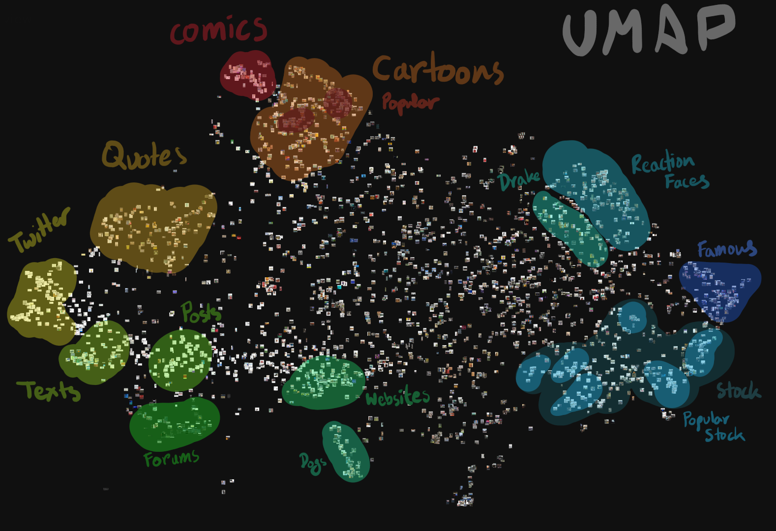

Slide 30
Contributors
Abir Rahman
Marketing with Twitter
A Study of Meme Propagation
Jawad Aziz Khan
Going Deeper with Convolutions
Visualizing Data with TSNE
Taufiq Rahman
Insights into Internet Memes
Predicting the Content Diffusion Path in Online Social Networks

Slide 31


Any Questions?

Slide 32
